Slide 1
Project NLP | Automated Customers Reviews
Collaborators: Dan Bigman
Paola Rivera

Slide 2
Purpose:
The goal of this project is to classify customer reviews from Amazon into three categories: Positive, Neutral, and Negative.
Importance:
Accurate review classification helps businesses optimize customer service and marketing strategies by identifying customer sentiment more efficiently.

Slide 3
Machine Learning
Approach

Slide 4
Exploring Data
Data Description
Columns:
categories: Product categories (e.g., 'Electronics', 'Tablets', etc.)
reviews.rating: Ratings from 1 to 5.
reviews.text: Textual reviews.
Dataset Size:
50,000+ customer reviews collected from Amazon.
Data Issues:
Imbalanced Classes: Some reviews had fewer negative ones than positive.
Missing Data: Some rows contained missing or incomplete review text.
Preprocessing:
Focused on necessary columns.
Removed duplicates.
Handled missing values by filling them with default text.
Standardized text (converted to lowercase, removed special characters).

Slide 5
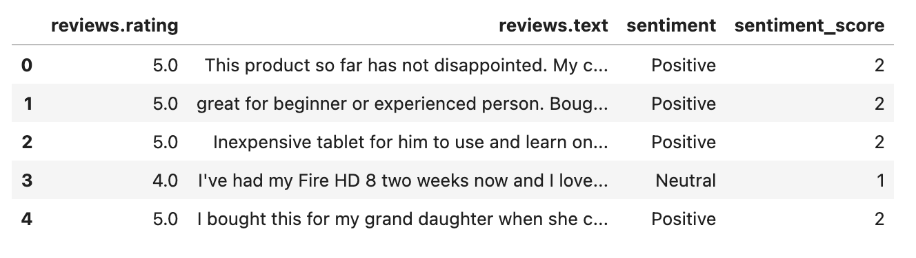
Sentiment Labeling & Cleaning
Sentiment Labeling: Assigning Scores:
Amazon reviews have ratings from 1 to 5, but for sentiment analysis, we grouped them as:
Negative (0): Ratings 1 & 2 → Represents dissatisfaction.
Neutral (1): Rating 3 → Mixed or neutral reviews.
Positive (2): Ratings 4 & 5 → Represents satisfaction.
This numeric encoding (0,1,2) allows machine learning models to treat sentiment as a classification task.

Slide 6
Feature Engineering
Text Preprocessing Steps:
Tokenization: Split the reviews into individual words.
Removing Stopwords: Removed common but unimportant words (e.g., “the”, “and”).
Lemmatization: Reduced words to their base form (e.g., “better” becomes “good”).
Text Vectorization:
TF-IDF Vectorizer: Used to transform the text into numerical features based on term frequency and inverse document frequency.
Feature Creation: Added features like review length and sentiment scores to help improve model performance.

Slide 7
Model Selection & Training
Models Used:
Logistic Regression
Random Forest
SVM (Support Vector Machine)
Naive Bayes
Steps Taken:
Trained each model using 80% of the data and tested on the remaining 20%.
Tuned models using GridSearchCV to find the best hyperparameters.
Evaluation Metrics:
Focused on accuracy, precision, recall, and F1-score due to imbalanced classes.

Slide 8
Naive Bayes
Class | Precision | Recall | F1-Score | Support
0 (Negative) | 0.8 | 0.01 | 0.02 | 462
1 (Neutral) | 0.48 | 0.08 | 0.13 | 1709
2 (Positive) | 0.71 | 0.99 | 0.83 | 4755
Accuracy | - | - | 0.7 | 6926
Macro Avg | 0.66 | 0.36 | 0.33 | 6926
Weighted Avg | 0.66 | 0.7 | 0.6 | 6926

Slide 9
Logistic Regression
Class | Precision | Recall | F1-Score | Support
0 (Negative) | 0.63 | 0.27 | 0.38 | 462
1 (Neutral) | 0.53 | 0.24 | 0.33 | 1709
2 (Positive) | 0.76 | 0.95 | 0.84 | 4755
Accuracy | - | - | 0.73 | 6926
Macro Avg | 0.64 | 0.49 | 0.52 | 6926
Weighted Avg | 0.69 | 0.73 | 0.68 | 6926

Slide 10
Support Vector Machine
Class | Precision | Recall | F1-Score | Support
0 (Negative) | 0.62 | 0.26 | 0.37 | 462
1 (Neutral) | 0.55 | 0.15 | 0.23 | 1709
2 (Positive) | 0.74 | 0.97 | 0.84 | 4755
Accuracy | - | - | 0.72 | 6926
Macro Avg | 0.64 | 0.46 | 0.48 | 6926
Weighted Avg | 0.68 | 0.72 | 0.66 | 6926

Slide 11
Random Forest
Class | Precision | Recall | F1-Score | Support
0 (Negative) | 0.69 | 0.1 | 0.17 | 462
1 (Neutral) | 0.56 | 0.12 | 0.2 | 1709
2 (Positive) | 0.72 | 0.98 | 0.83 | 4755
Accuracy | - | - | 0.71 | 6926
Macro Avg | 0.65 | 0.4 | 0.4 | 6926
Weighted Avg | 0.68 | 0.71 | 0.63 | 6926

Slide 12
Model Summary
Model | Accuracy
Naive Bayes | 0.7001
Logistic Regression | 0.7274
Support Vector Machine | 0.7216
Random Forest | 0.7109

Slide 13
Model Selection & Training
Class Imbalance Issue:
The dataset had significantly more positive reviews (ratings 4 & 5) than negative reviews (ratings 1 & 2).
Training models on this imbalanced dataset would make them biased towards predicting positive reviews.
Steps Taken:
Applied SMOTE on the training set to balance the distribution of positive and negative reviews.
Ensured the dataset had an approximately equal number of positive and negative samples before training.
Used stratified sampling to maintain distribution in the test set.
Results of SMOTE Application:
Models trained on balanced data showed higher recall for negative reviews, meaning they could better detect dissatisfied customers.

Slide 14
Model Selection & Training
Class | Precision | Recall | F1-Score | Support
0 (Negative) | 0.3 | 0.65 | 0.41 | 462
1 (Neutral) | 0.36 | 0.43 | 0.39 | 1709
2 (Positive) | 0.82 | 0.68 | 0.74 | 4755
Accuracy | - | - | 0.61 | 6926
Macro Avg | 0.5 | 0.58 | 0.52 | 6926
Weighted Avg | 0.67 | 0.61 | 0.63 | 6926

Slide 15
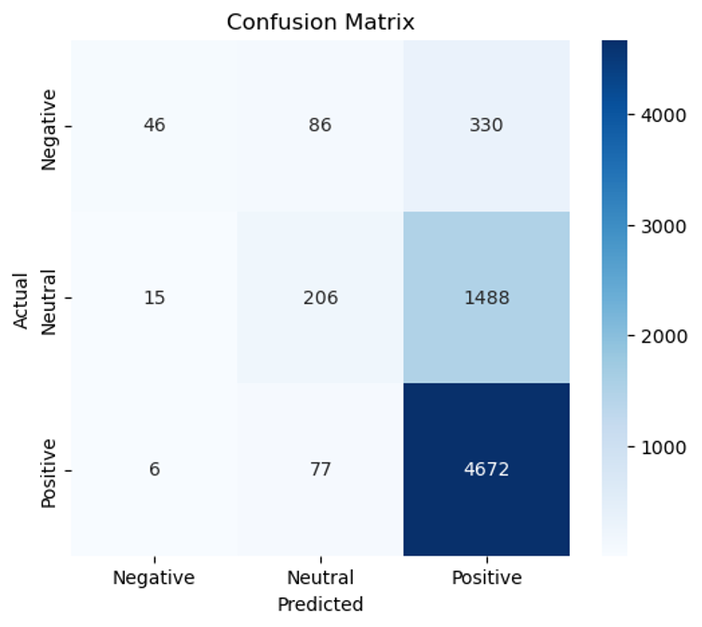
Model Selection & Training

Slide 16
Deep Learning
Approach

Slide 17
Transformer-Based Sentiment Analysis Model
Model Name: bert-base-multilingual-uncased-sentiment
Finetuning: Specifically finetuned for sentiment analysis on product reviews
Category | Precision | Recall | F1-Score | Support
NEGATIVE | 0.29 | 0.33 | 0.31 | 2.311
NEUTRAL | 0.37 | 0.07 | 0.12 | 8,541
POSITIVE | 0.72 | 0.92 | 0.81 | 23,775
Strengths:
High accuracy (67.48%) and strong positive sentiment detection.
Weaknesses:
Poor performance on neutral (F1 = 0.12) and negative (F1 = 0.31) sentiment.
Over-classification of reviews as positive.

Slide 18
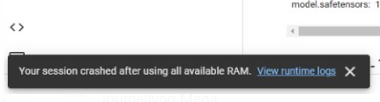
To - Do
Finetuning
Address data imbalance (resampling or weight loss function)

Slide 19
Bonus

Slide 20
Generative AI for Review Summarization
Objective:
To summarize customer reviews for better insight and quicker decision-making.
Why Generative AI?
Summarization helps in giving quick insights without reading all reviews.
Especially useful for categories with thousands of reviews.
Example Summaries:
Example 1: "Great battery life and fast performance, but the screen is fragile."
Example 2: "The tablet works fine, but the price is too high for the specs."

Slide 21
Interactive Visualization
Objective:
To allow users to interactively explore review summaries by category and rating.
Steps Taken:
Built an interactive dashboard using Plotly Dash.
Users can select a category and rating, and view a summary of the reviews for that combination.
Generated a word cloud for positive and negative reviews to find common words.
Features:
Dropdown to select category.
Tables or Charts to display the summarized reviews.
Result:
Users can quickly gain insights into reviews for each product category.

Slide 22
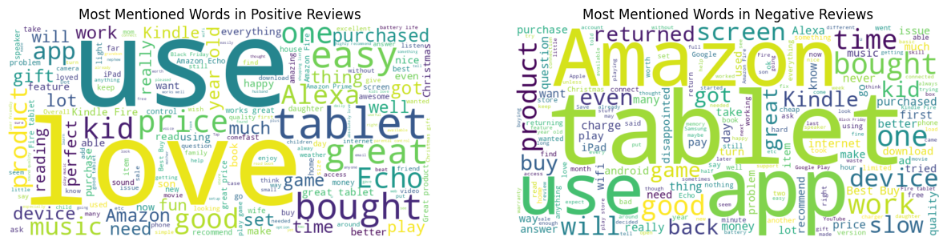
Interactive Visualization

Slide 23
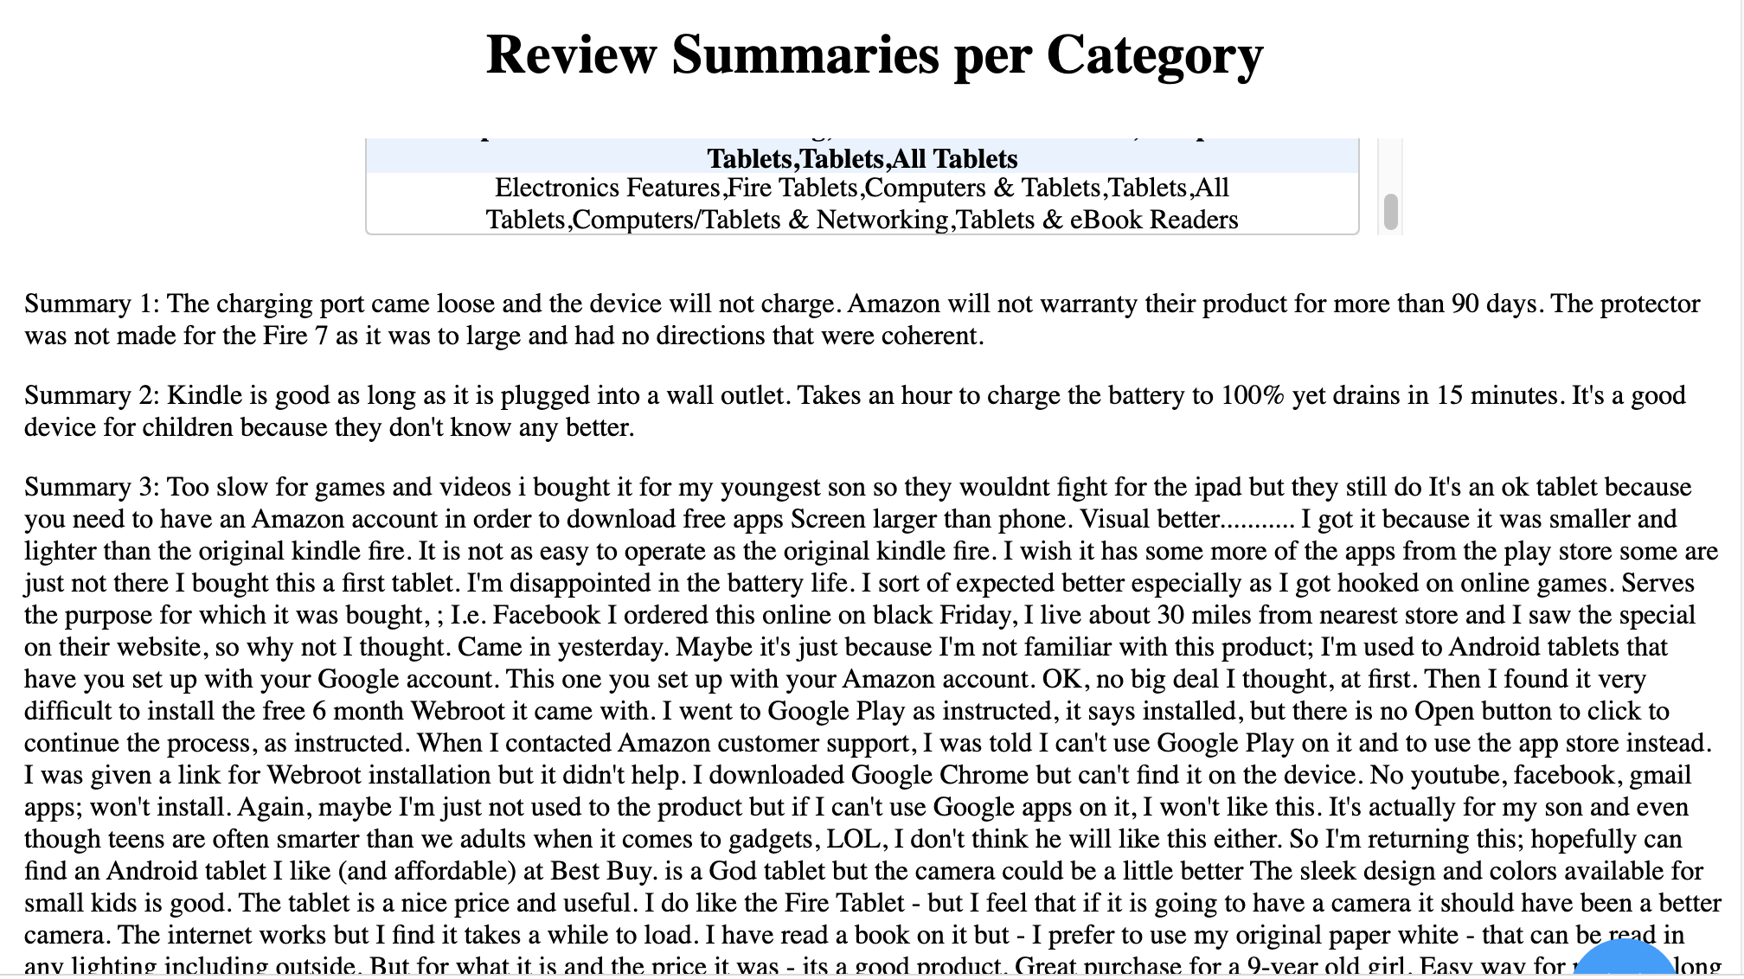
Interactive Visualization

Slide 24
THANK YOU!

